Slide 1

Amazon product availability checker using Python

Slide 2
Introduction
What is an Amazon product availability checker?
Why use Python for Amazon product availability checker?
Building an Amazon product availability checker using Python
Testing and troubleshooting
Conclusion

Slide 3

Introduction
Welcome to this presentation on Amazon product availability checker using Python.
In today's world, where online shopping has become a norm, it is essential to have a tool that can help you keep track of the availability of your desired products on Amazon. This is where an Amazon product availability checker comes into play. By using Python, we can build a tool that can automatically check the availability of products on Amazon and notify us when they become available. This can save us time and effort, especially when dealing with products that are in high demand.

Slide 4

What is an Amazon product availability checker?
An Amazon product availability checker is a tool that allows users to monitor the availability of products on Amazon. It works by periodically checking the product page for changes in availability status, such as when an item goes out of stock or becomes available again.
The tool can also be used to track price changes, with some checkers even allowing users to set up alerts for when prices drop below a certain threshold. This can be particularly useful for shoppers who are looking to buy a specific product but want to wait until it goes on sale.
This Photo by Unknown Author is licensed under CC BY-SA-NC

Slide 5

Why use Python for Amazon product availability checker?
Python is a popular programming language that is widely used in the field of data science, web development, and automation. It is a versatile language that is easy to learn and use, making it an ideal choice for building an Amazon product availability checker.
One of the main benefits of using Python for building an Amazon product availability checker is its extensive library of modules and packages. Python has a vast collection of libraries that can be used for web scraping, data analysis, and automation. For example, the Beautiful Soup library can be used to extract data from HTML and XML files, while the Requests library can be used to send HTTP requests and handle responses.
This Photo by Unknown Author is licensed under CC BY-NC-ND

Slide 6
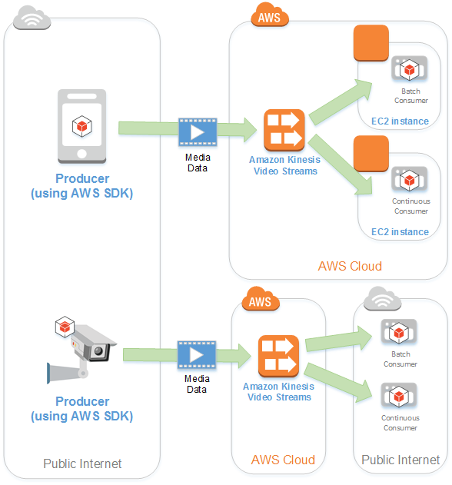
Building an Amazon product availability checker using Python
To build an Amazon product availability checker using Python, we first need to install the necessary libraries. We can use the BeautifulSoup library to parse HTML and extract information from web pages, and the Requests library to make HTTP requests to web pages. Once we have these libraries installed, we can start building our program.
The first step is to identify the URL of the Amazon product we want to check. We can then use the Requests library to send an HTTP request to the URL and retrieve the HTML content of the page. Next, we can use the BeautifulSoup library to parse the HTML content and extract the relevant information, such as the product's title, price, and availability status. Finally, we can output this information in a user-friendly format, such as a text message or email.
This Photo by Unknown Author is licensed under CC BY-NC-ND

Slide 7

Testing and troubleshooting
Once you have built your Amazon product availability checker using Python, it is important to thoroughly test and troubleshoot it before deploying it in a production environment. One way to do this is by using unit tests to ensure that each individual component of the program is functioning correctly. This can help identify any bugs or errors early on in the development process, which can save time and resources down the line.
Another important aspect of testing and troubleshooting is to simulate real-world scenarios and edge cases. For example, you may want to test the program's ability to handle unexpected inputs or network failures. By testing these scenarios, you can ensure that your product availability checker will be reliable and accurate in a variety of situations.
This Photo by Unknown Author is licensed under CC BY-SA-NC

Slide 8

Conclusion
In conclusion, we have learned that an Amazon product availability checker is a useful tool for monitoring the availability of products on Amazon. By using Python to build this tool, we can take advantage of its powerful libraries and easy-to-learn syntax. Python allows us to quickly and efficiently scrape data from Amazon's website and process it in a way that is useful for our needs.
Furthermore, Python's versatility means that we can use it to build other tools beyond just an Amazon product availability checker. With its popularity and widespread use, there is a vast community of developers who are constantly creating new libraries and tools that we can leverage in our own projects.

